Slide 1
Botanicapp
CS50x Final Project
by Arkadiusz Jędrzejewski (arek_jedrzejewski)
Gdańsk, Poland
2022-09-19

Slide 2
DESCRIPTION
CRUD application to maintan your plants
You can name your plant, add photo and description (e. g. watering schedule)
You can edit or delete persisted plants
App uses SQLite database (with usage of Room Framework)
Implemented in Kotlin

Slide 3
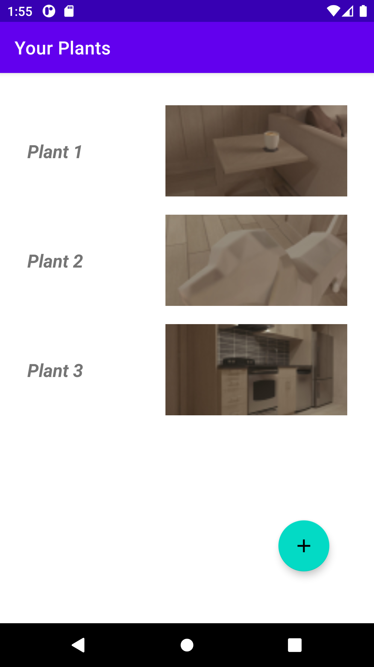
Main view
List of all your plant with photo thumbnail
Click on plant to view details page
Click on ( + ) button to add new plant
Click!

Slide 4
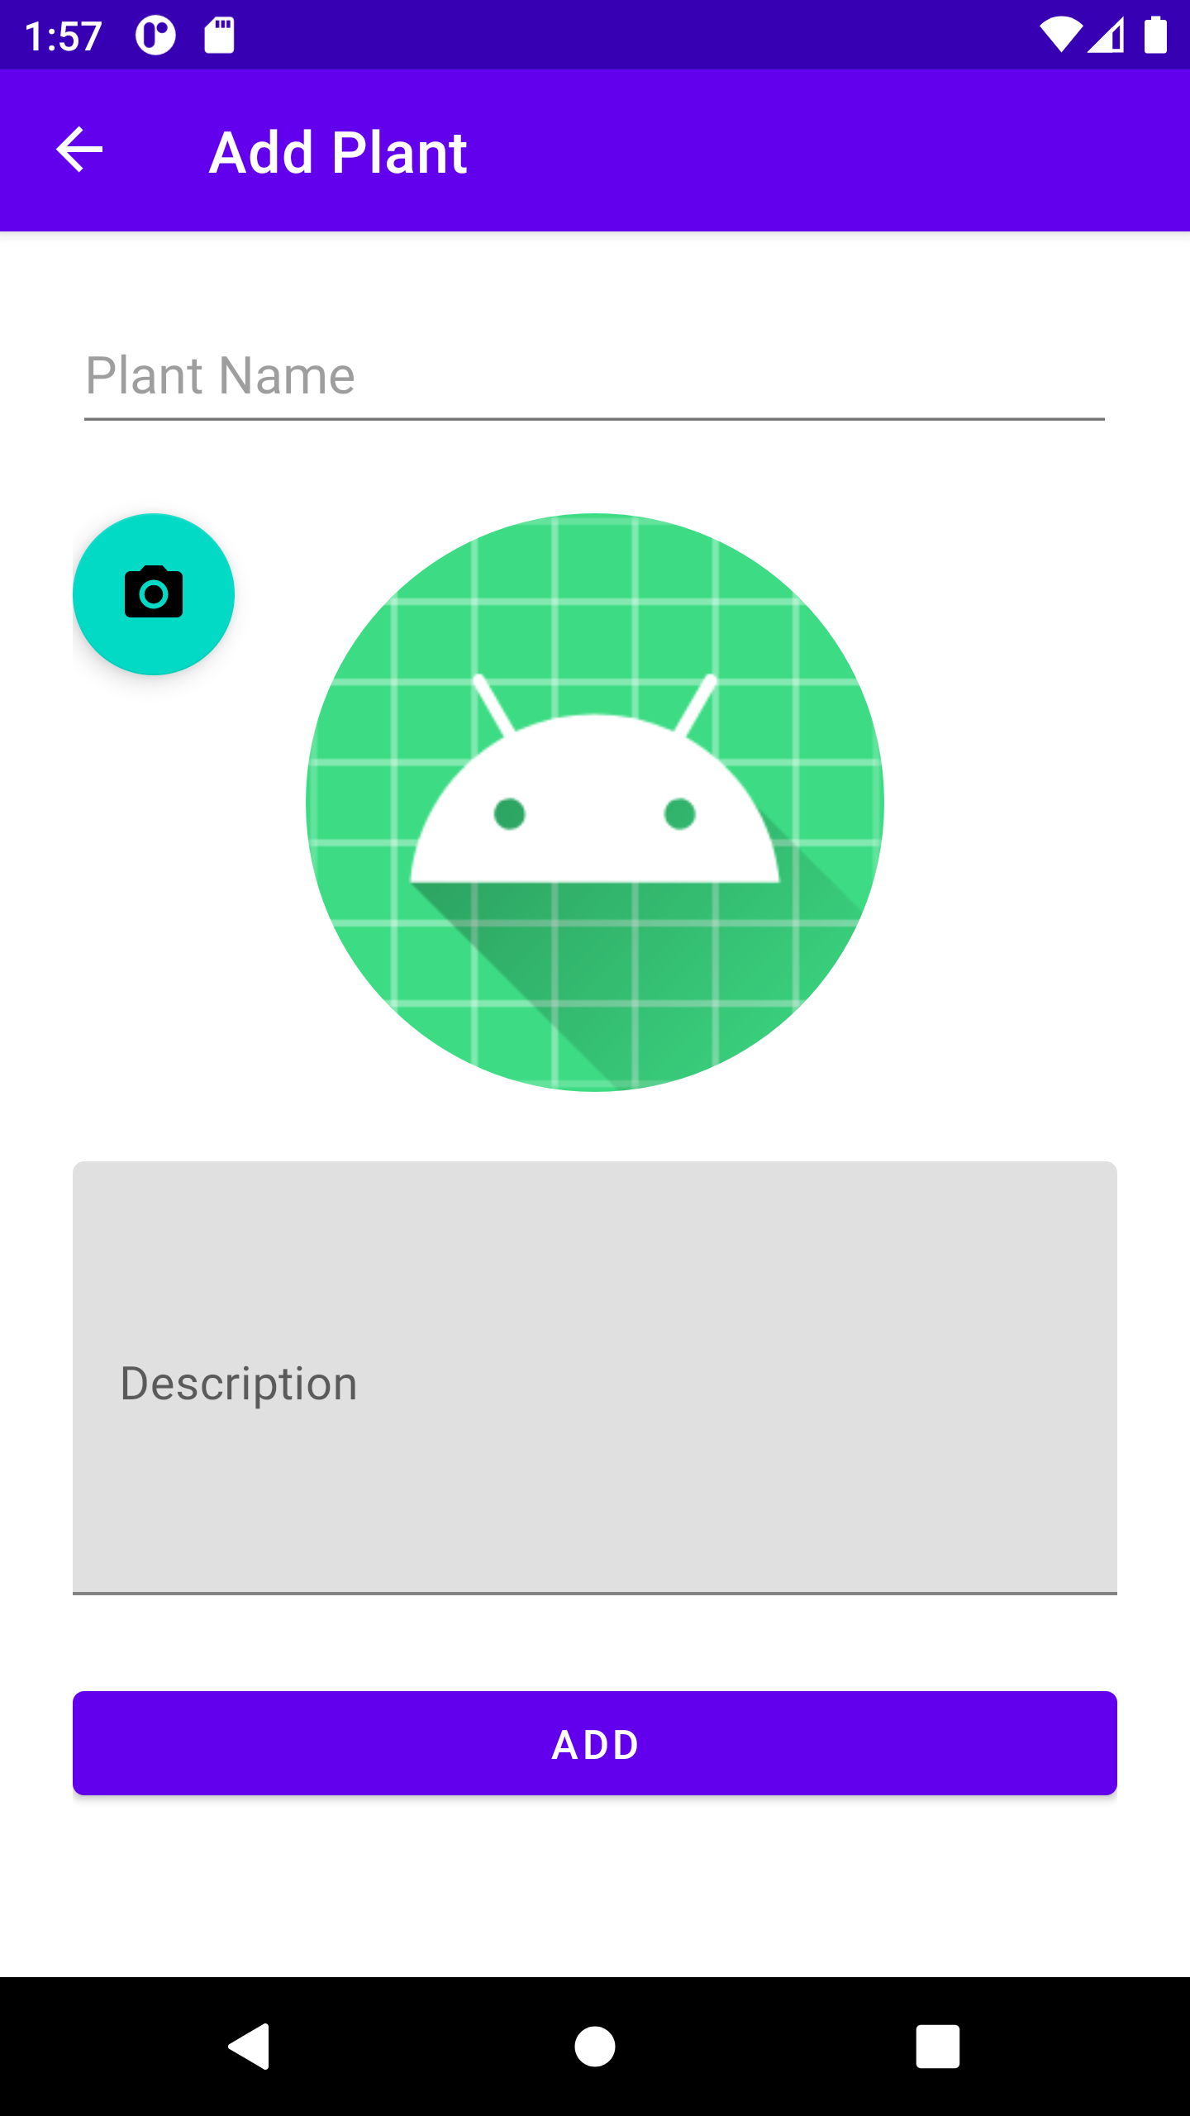
add view
Fields to provide plant name and description
Camera button allows to add plant photo
Central item (with android logo) allows to preview captured photo
Click!

Slide 5
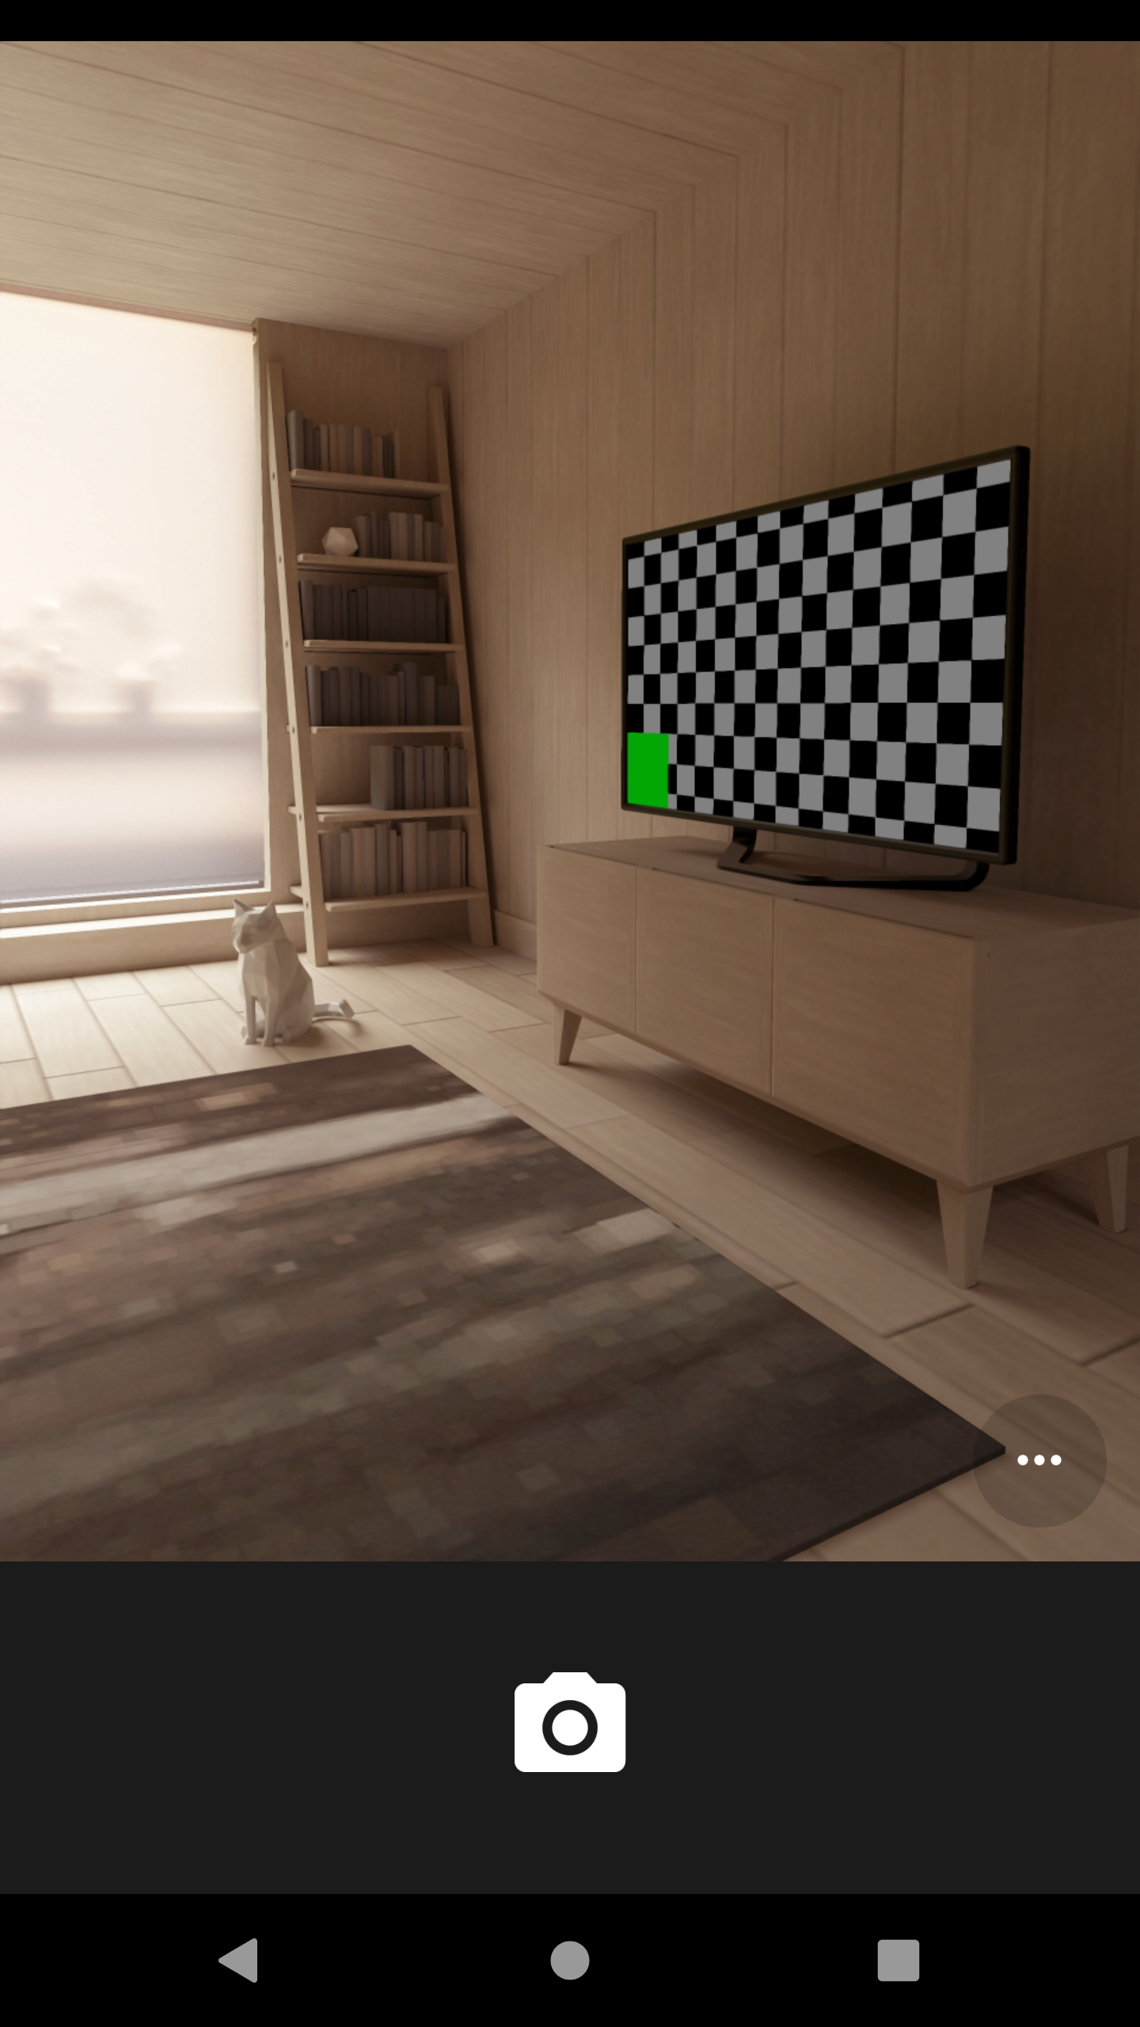
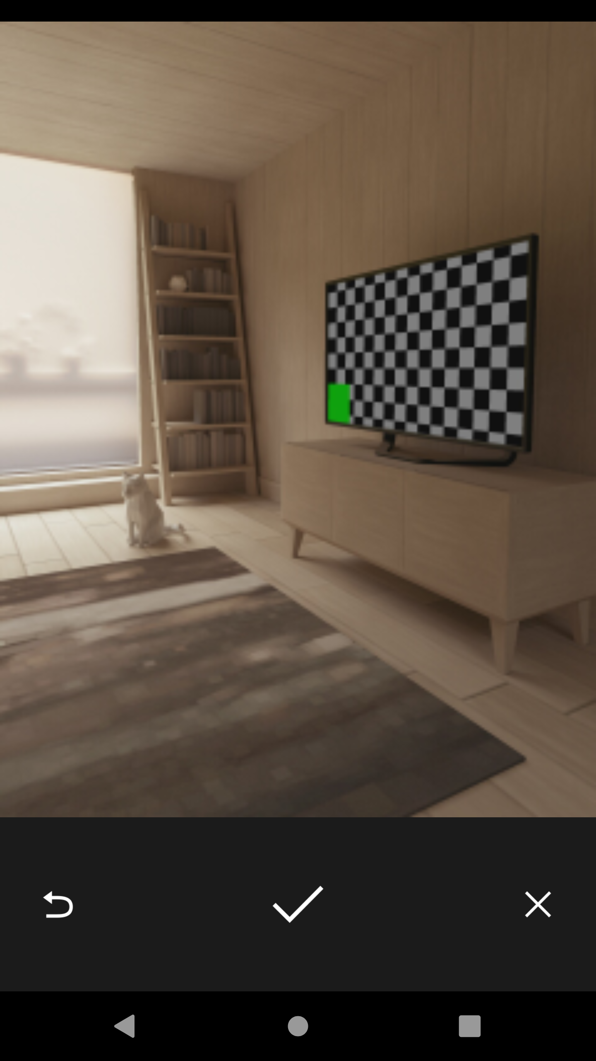
camera
This feature allows to capture photo
After capturing you can accept or decline created image
App returns to ADD VIEW after closing Camera
Click!

Slide 6
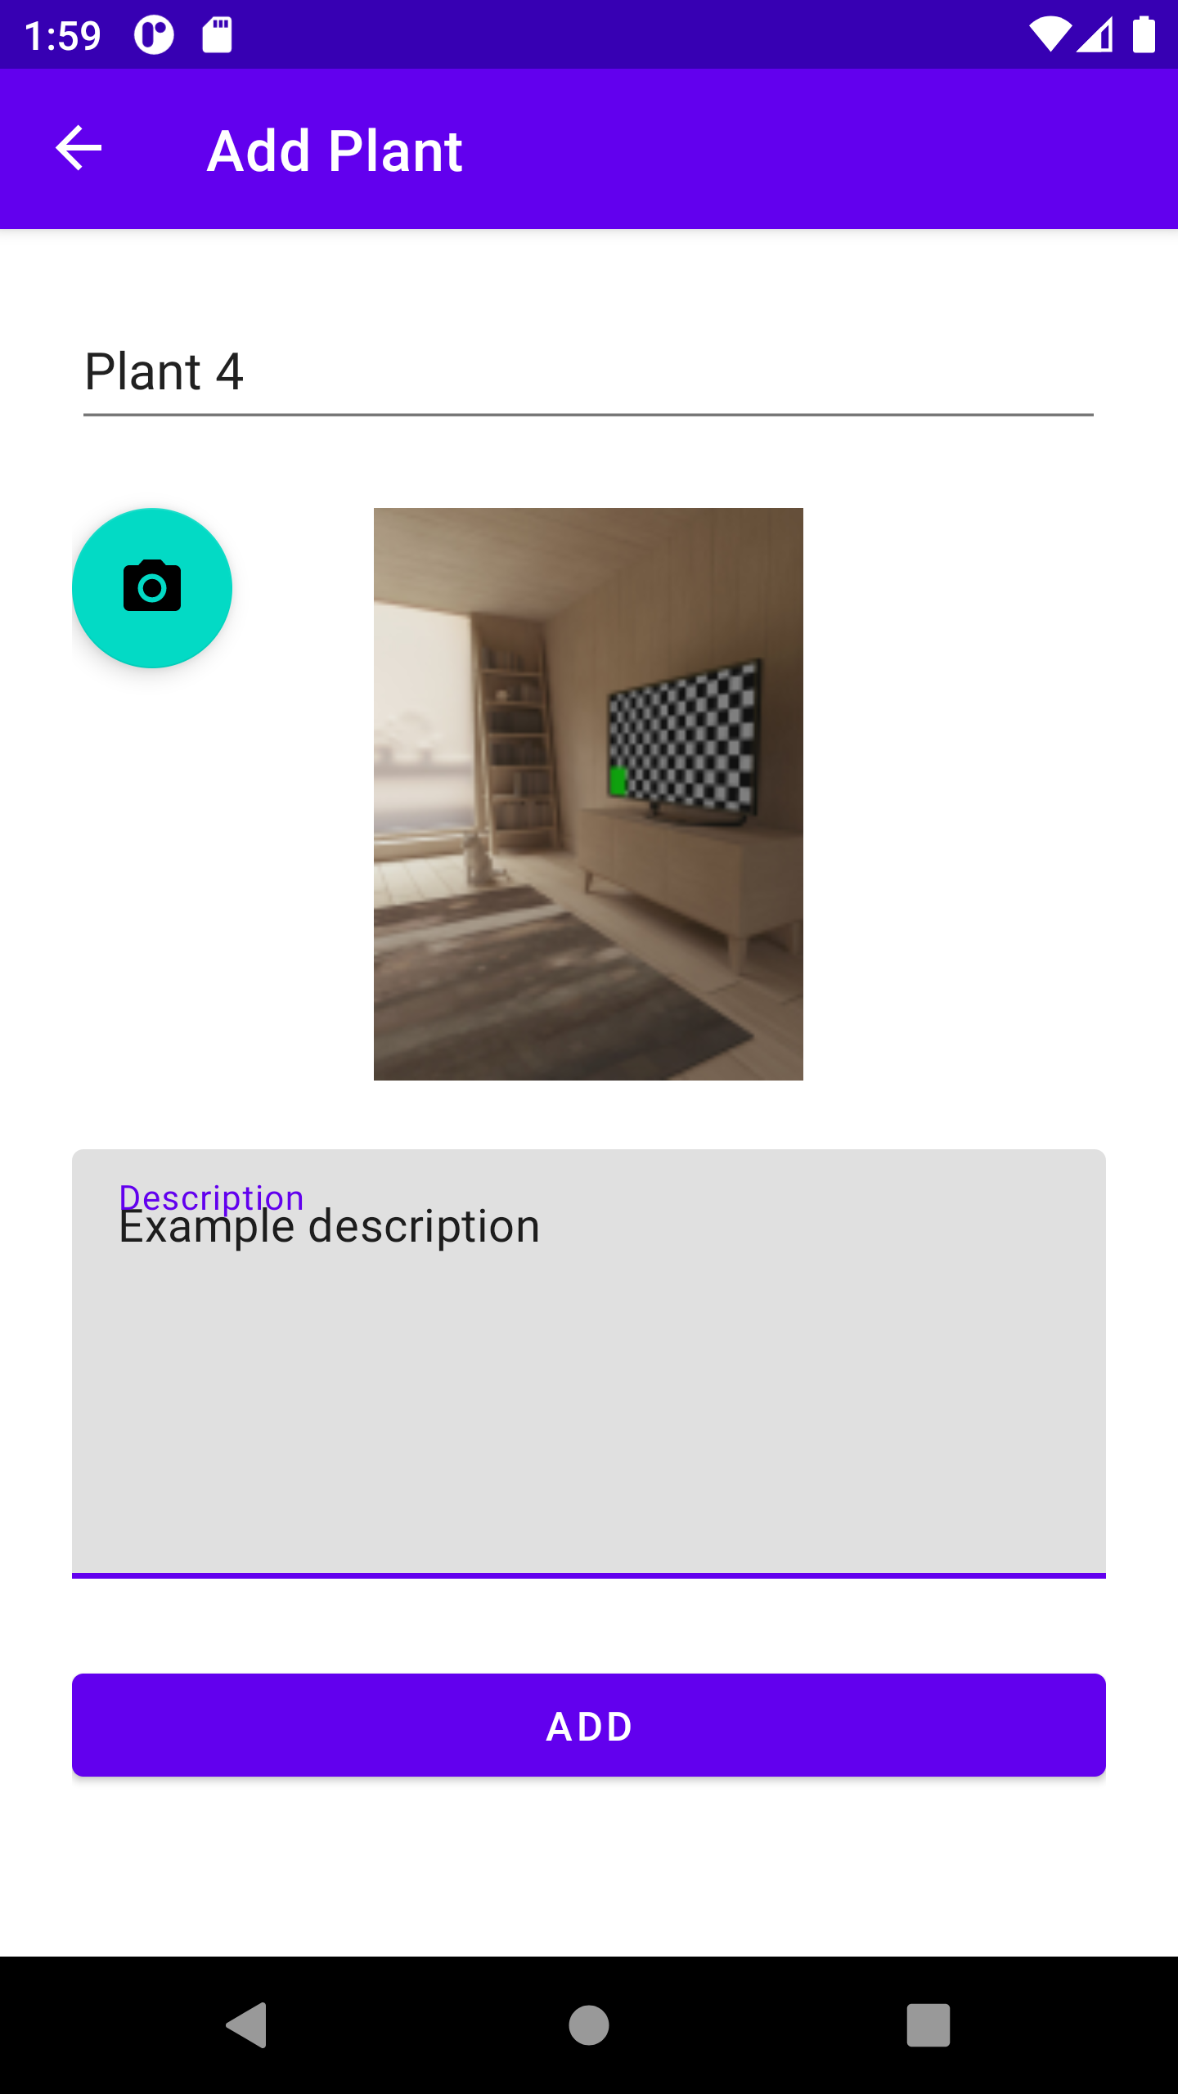
Add view (filled)
Filled form allows you to create new plant
Next app is returning to MAIN VIEW
Click!

Slide 7
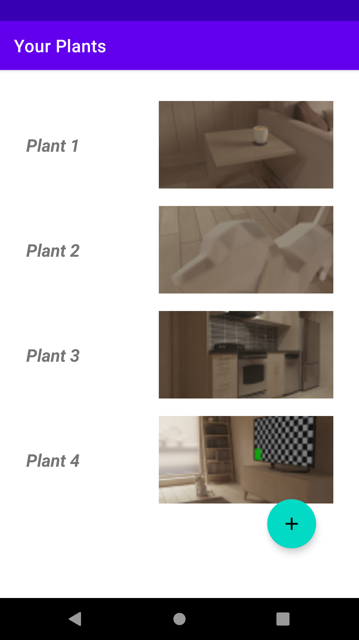
Main view with new plant
You can click on chosen plant to open its details
Click!

Slide 8
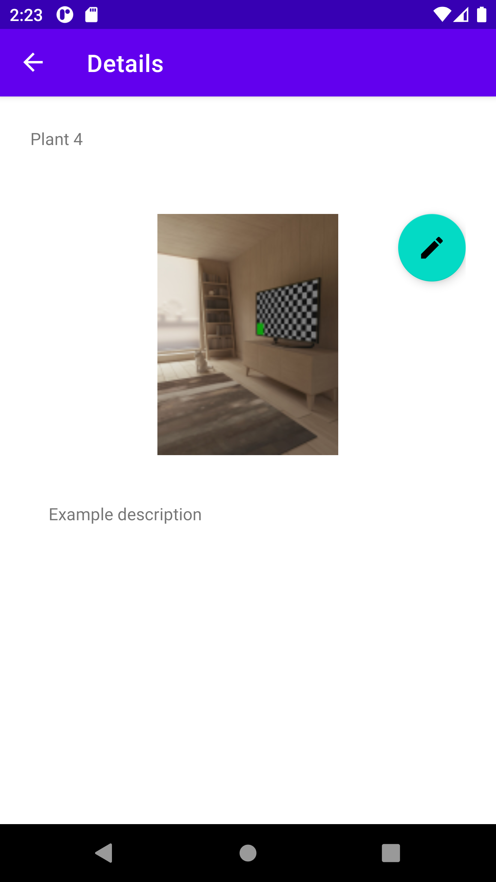
Details view
Here you can see everything about your plant
Click on Pen Icon to edit this plant
Click!

Slide 9
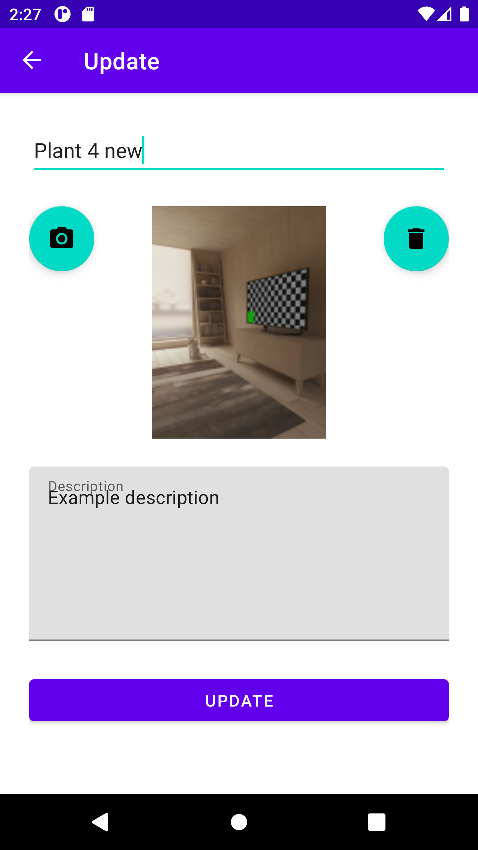
Update view
Edit demanded information
You can change photo as well
Confirm changes by clicking UPDATE - you will be redirected to DETAILS PAGE
Also, you can delete this plant from database by clicking Trashcan Icon
Click!
Click!

Slide 10
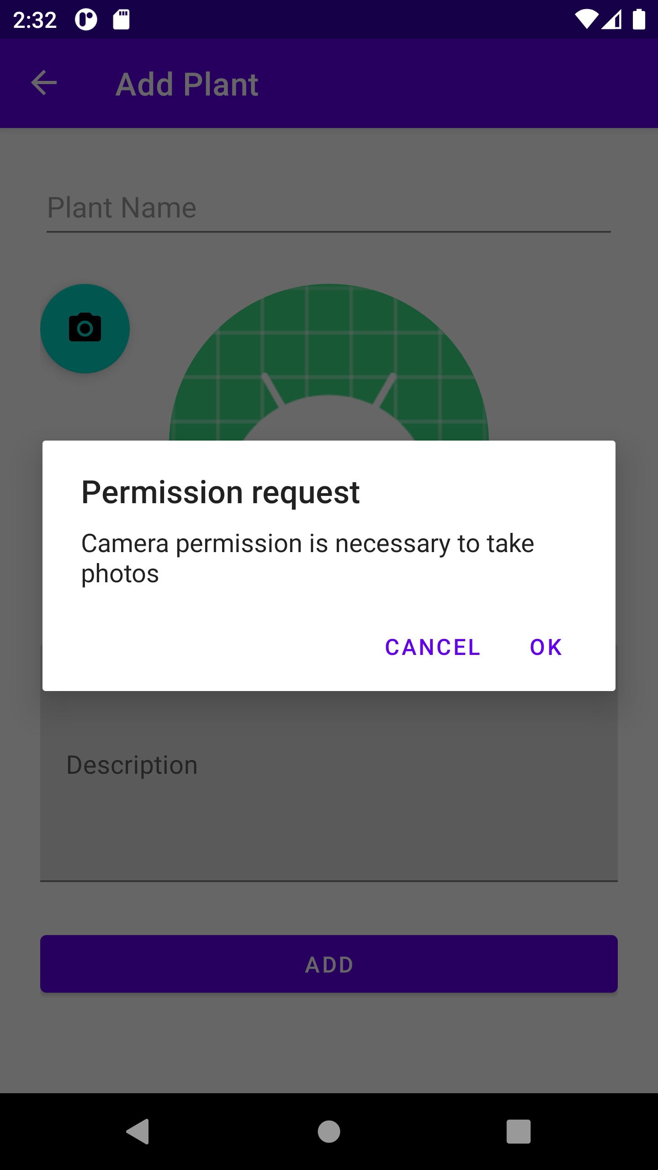
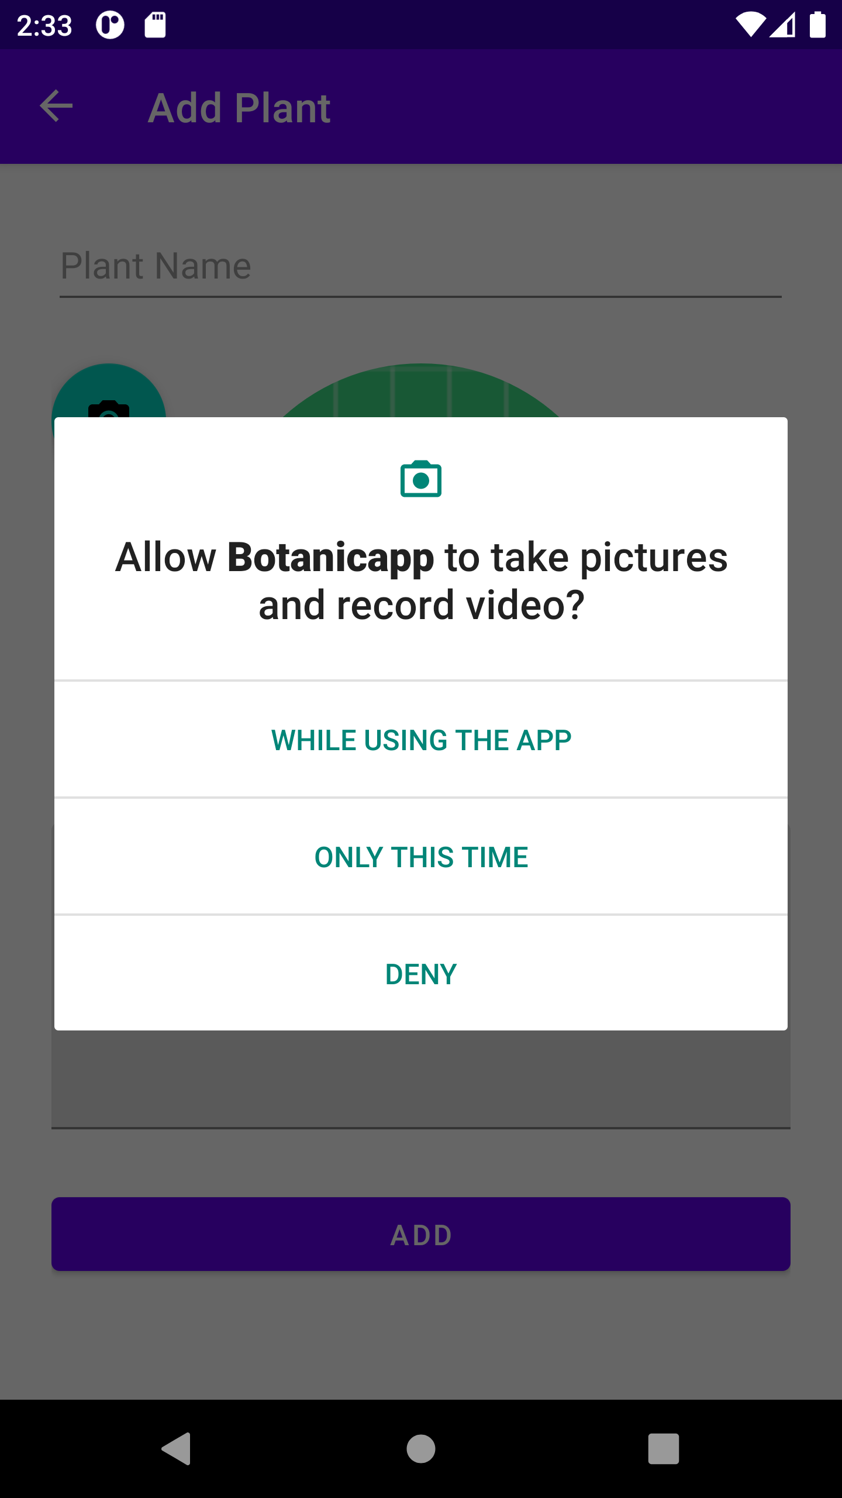
permissions
App requires Camera permission. User will be prompted to grant it.

Slide 11
Thank you!
That’t it ☺

